Slide 1
distance based non - linear model

Slide 2
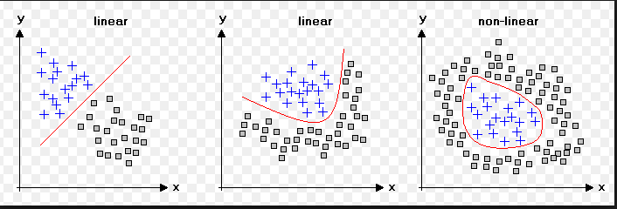

Slide 3
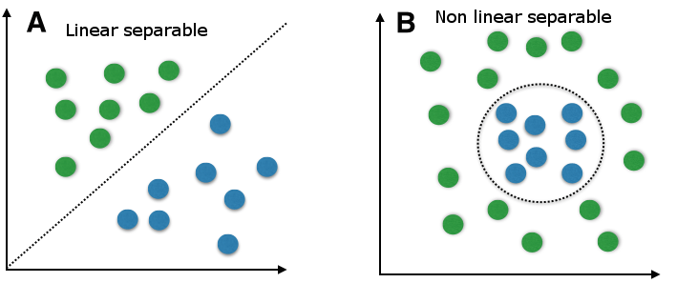

Slide 4
Pattern recognition
Pattern recognition is the automated recognition of patterns and regularities in data.
artificial intelligence
machine learning

Slide 5
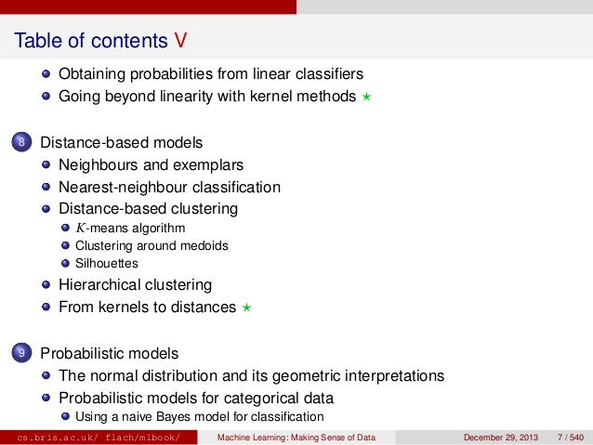

Slide 6
Linear Models
generalized linear model

Slide 7
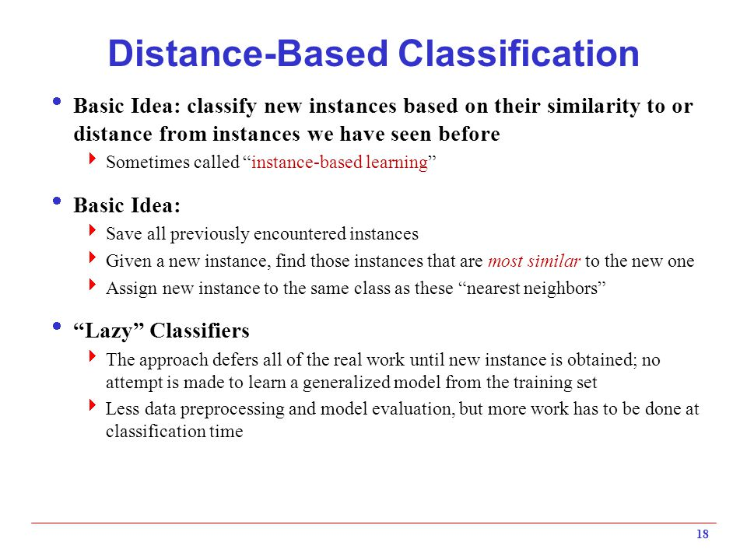

Slide 8
K-nearest Neighbour Classification
K-means
SVM
Cluster
Distance -
Veronoi diagram

Slide 9
Important
Euclidean distance
Manhattan
Minkopwski
Mahalnobis
Closest Centroid
Veronoi diagrams
Nearest Neighbours
Dimensionality
K-NN
Distance, Kernels
Clustering
SVM

Slide 10
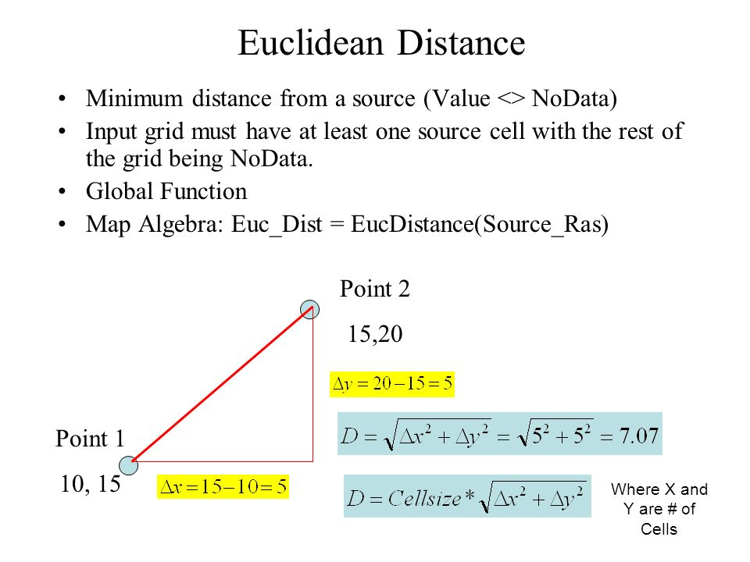
Euclidean distance

Slide 11
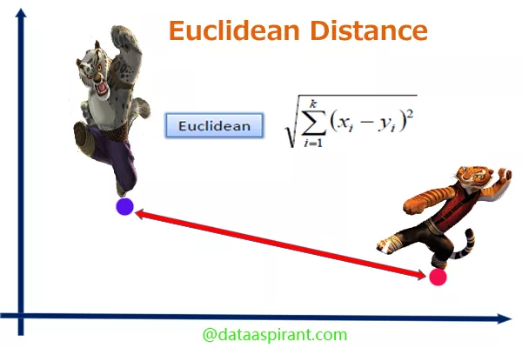

Slide 12
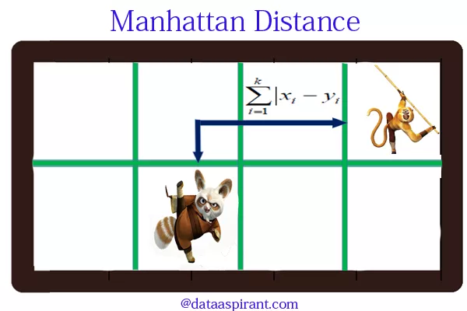

Slide 13
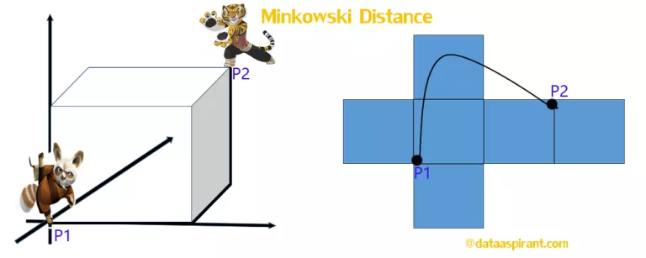
the Minkowski distance is a generalized metric form of Euclidean distance and Manhattan distance

Slide 14
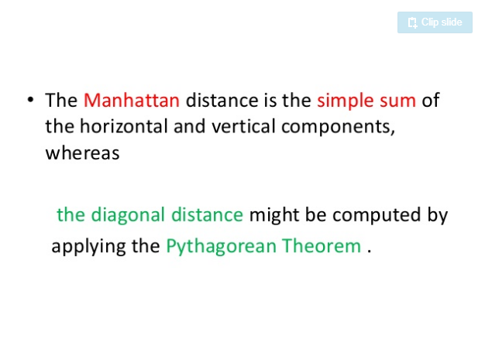

Slide 15
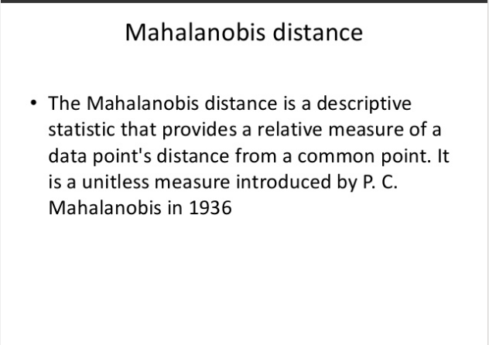

Slide 16
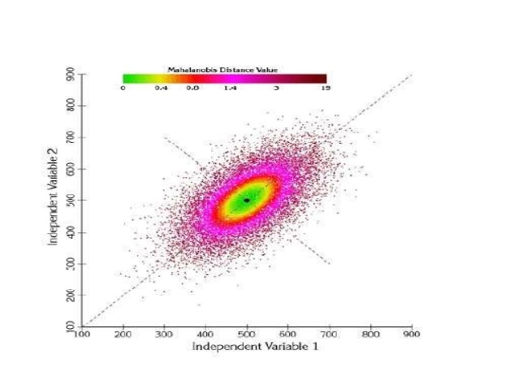

Slide 17
k-nearest neighbors algorithm
he k-nearest neighbors algorithm (k-NN) is a non-parametric method used for classification and regression.
In k-NN classification, the output is a class membership. An object is classified by a majority vote of its neighbors, with the object being assigned to the class most common among its k nearest neighbors (k is a positive integer, typically small). If k = 1, then the object is simply assigned to the class of that single nearest neighbor.
In k-NN regression, the output is the property value for the object. This value is the average of the values of its knearest neighbors.

Slide 18
k-NN is a type of instance-based learning, or lazy learning, where the function is only approximated locally and all computation is deferred until classification.
The k-NN algorithm is among the simplest of all machine learning algorithms

Slide 19
a useful technique can be used to assign weight to the contributions of the neighbors, so that the nearer neighbors contribute more to the average than the more distant ones.

Slide 20
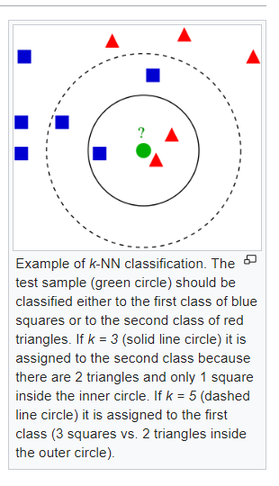

Slide 21
larger values of k reduces effect of the noise on the classification,
Feature extraction (face recognition )
dimension reduction
Decision boundary

Slide 22
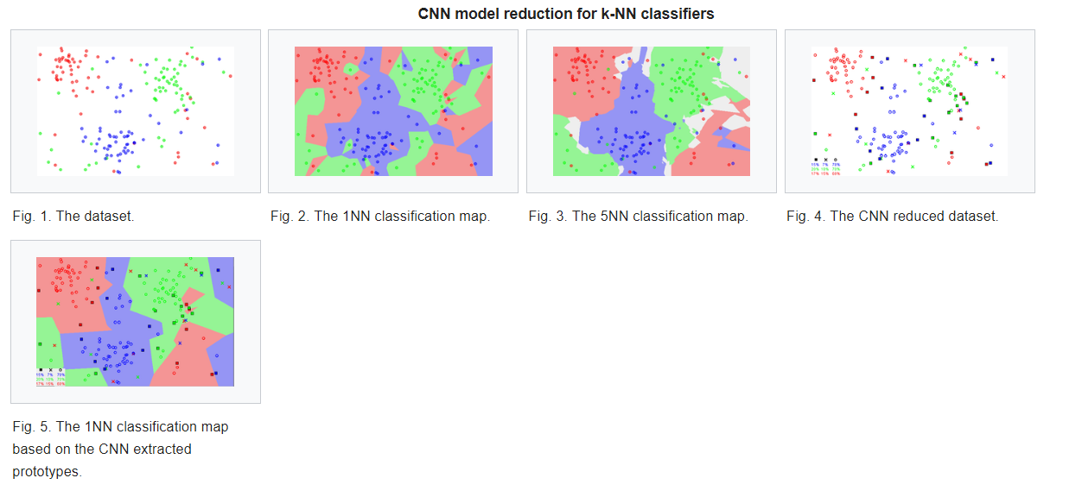

Slide 23
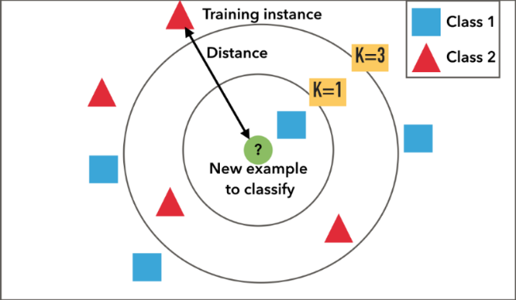

Slide 24
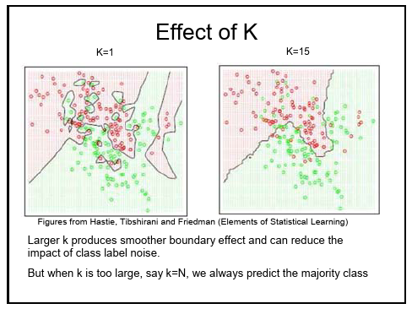

Slide 25
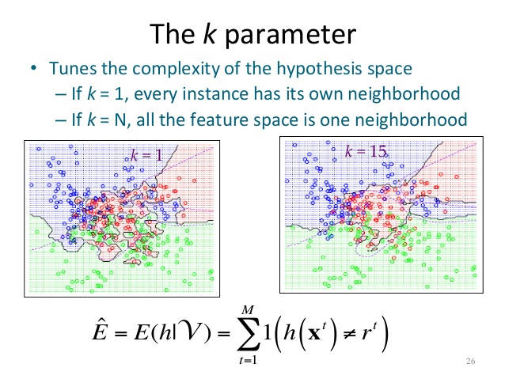

Slide 26
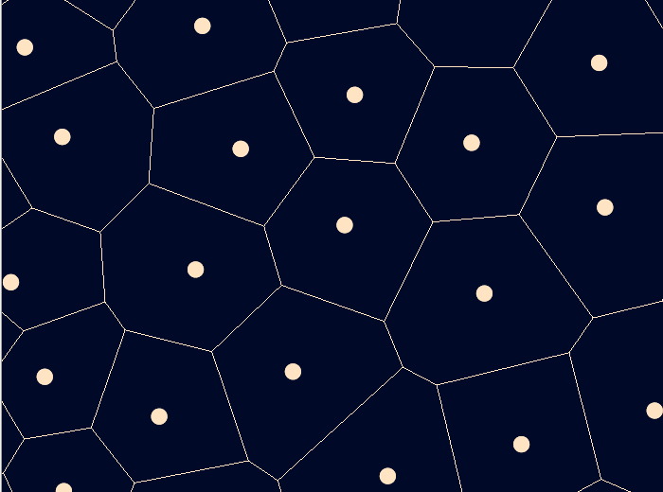
Voronoi cells

Slide 27
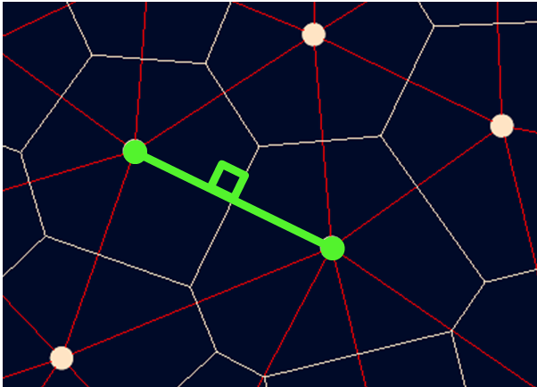

Slide 28
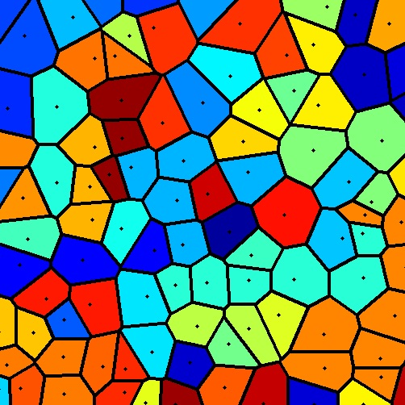

Slide 29
k-means clustering
This is different to K-NN nearest neighbour
that is popular for cluster analysis in data mining.
k-means clustering aims to partition
n observations into k clusters
in which each observation belongs to the cluster with the nearest mean,
serving as a prototype of the cluster.

Slide 30


Slide 31
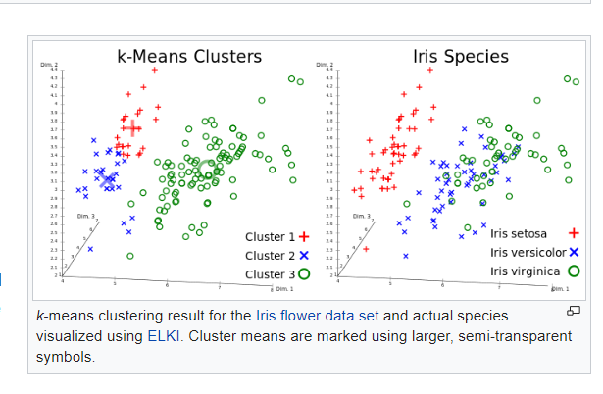

Slide 32
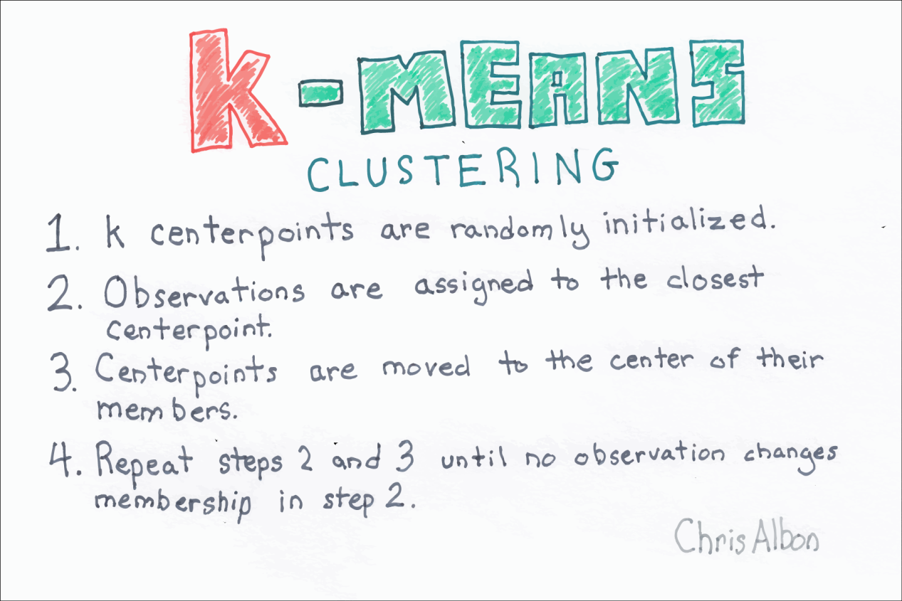

Slide 33
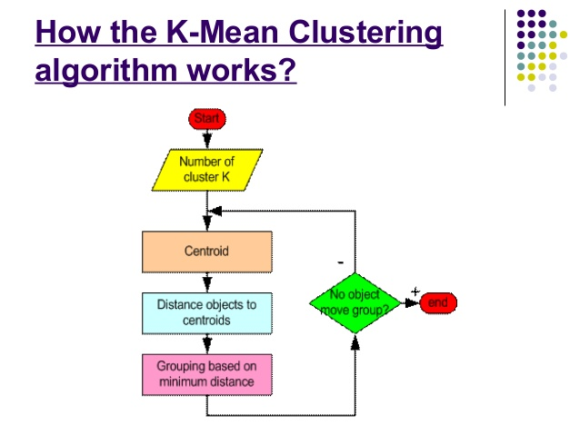

Slide 34
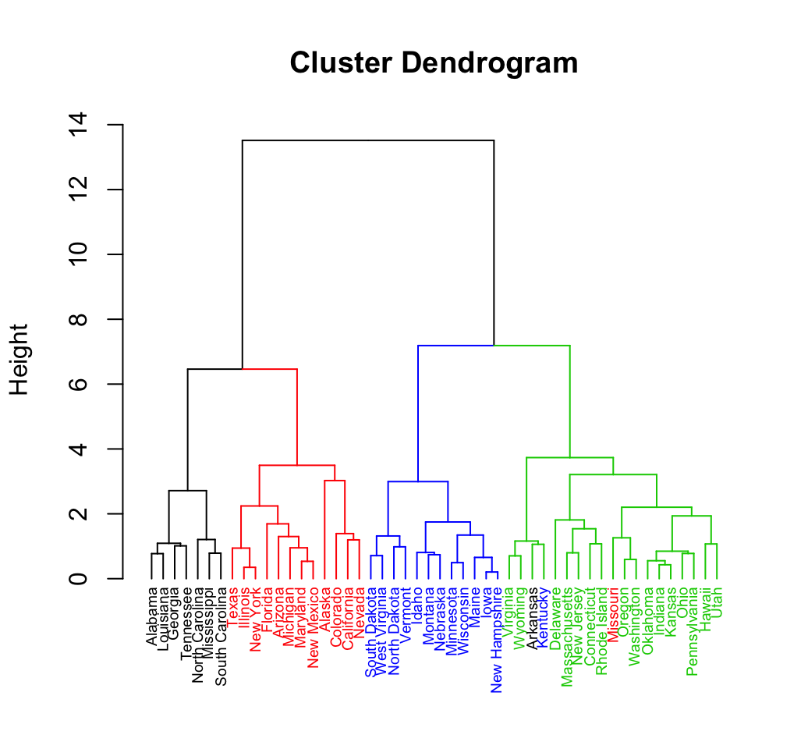

Slide 35
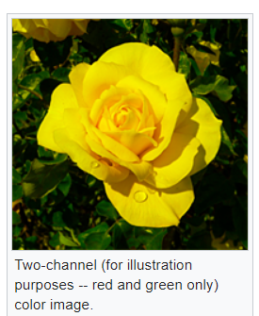

Slide 36
Cluster analysis[edit]
Feature learning

Slide 37
it is often called the k-means algorithm; it is also referred to as Lloyd's algorithm
Assignment step: (Euclidean distance )
Update step
The algorithm has converged when the assignments no longer change.
There is no guarantee that the optimum is found using this algorithm

Slide 38
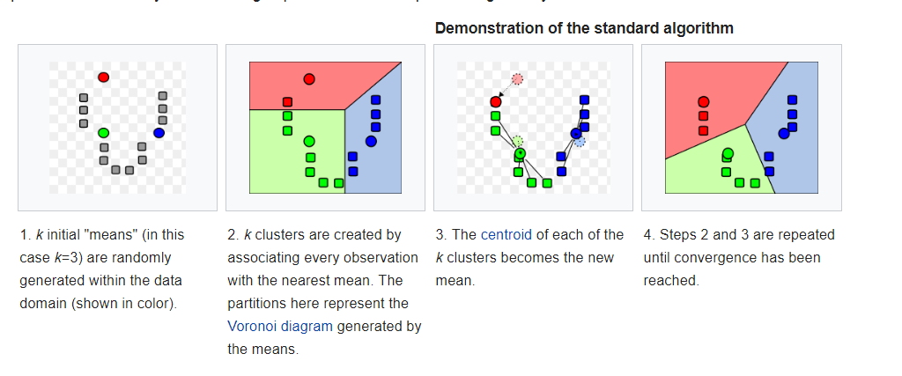

Slide 39
Heuristic (computer science)
heuristic (from Greek εὑρίσκω "I find, discover")
is a technique designed for solving a problem more quickly when classic methods are too slow,
or
for finding an approximate solution when classic methods fail to find any exact solution.

Slide 40
This is achieved by trading optimality, completeness, accuracy, or precision for speed. In a way, it can be considered a shortcut.
For example, it may approximate the exact solution

Slide 41
Trade-off
Optimality: When several solutions exist for a given problem, does the heuristic guarantee that the best solution will be found? Is it actually necessary to find the best solution?
Completeness: When several solutions exist for a given problem, can the heuristic find them all? Do we actually need all solutions? Many heuristics are only meant to find one solution.
Accuracy and precision: Can the heuristic provide a confidence interval for the purported solution? Is the error bar on the solution unreasonably large?
Execution time: Is this the best known heuristic for solving this type of problem? Some heuristics converge faster than others. Some heuristics are only marginally quicker than classic methods.

Slide 42
Virus scanning
Many virus scanners use heuristic rules for detecting viruses and other forms of malware.
Heuristic scanning looks for code and/or behavioral patterns common to a class or family of viruses, with different sets of rules for different viruses.
If a file or executing process is found to contain matching code patterns and/or to be performing that set of activities, then the scanner infers that the file is infected.

Slide 43
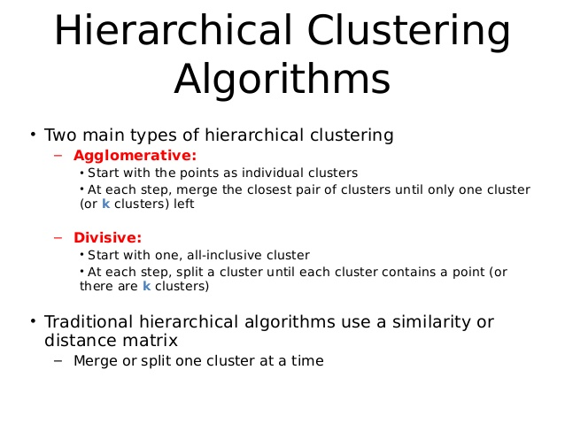

Slide 44
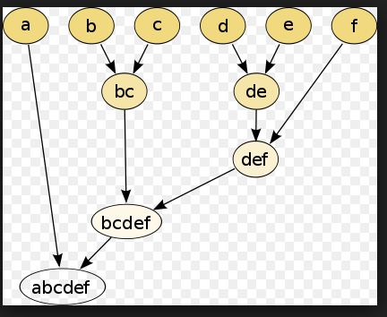

Slide 45
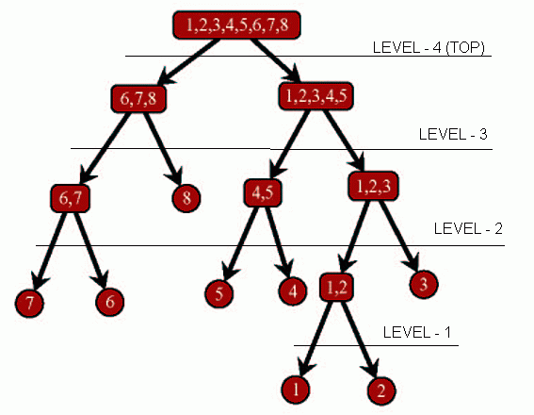

Slide 46
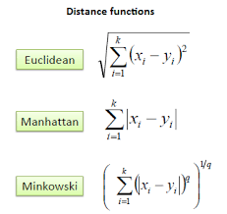

Slide 47
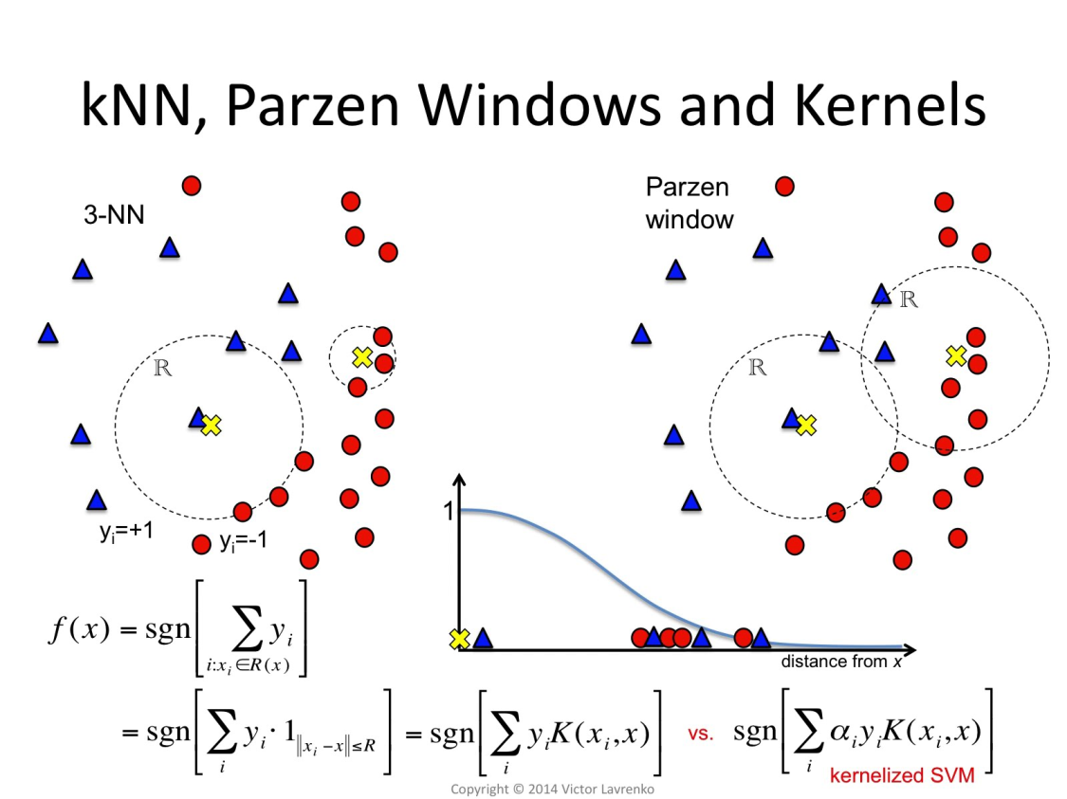

Slide 48
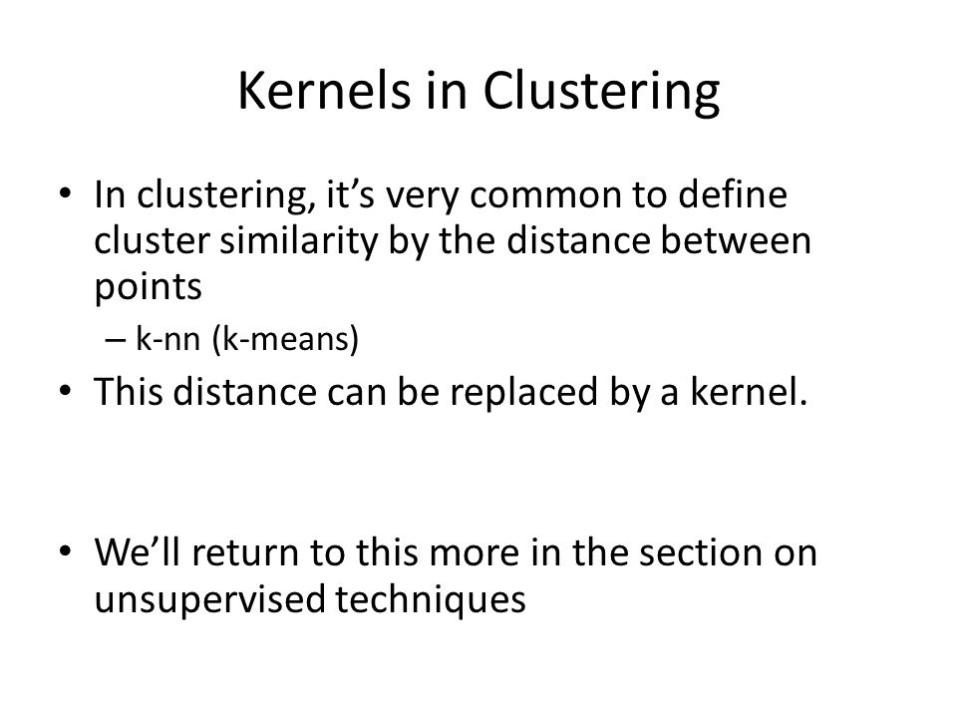

Slide 49
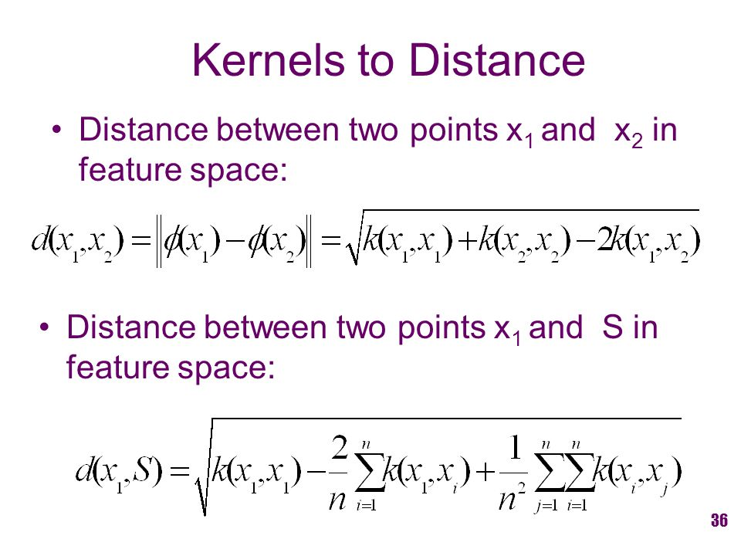

Slide 50
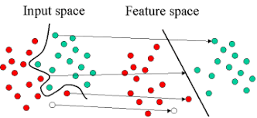
support vector machine

Slide 51
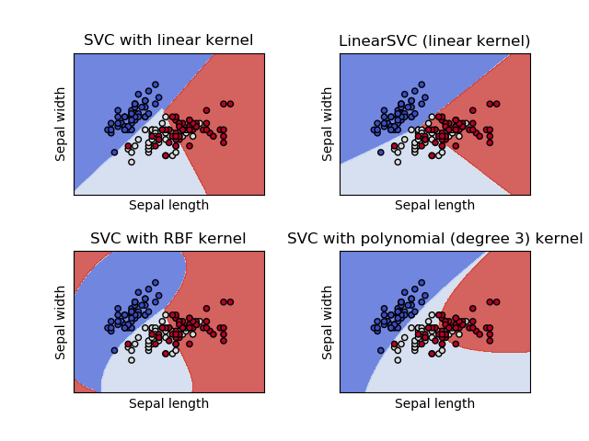
SVM classifier

Slide 52
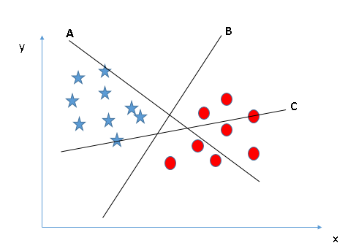
SVM plane

Slide 53
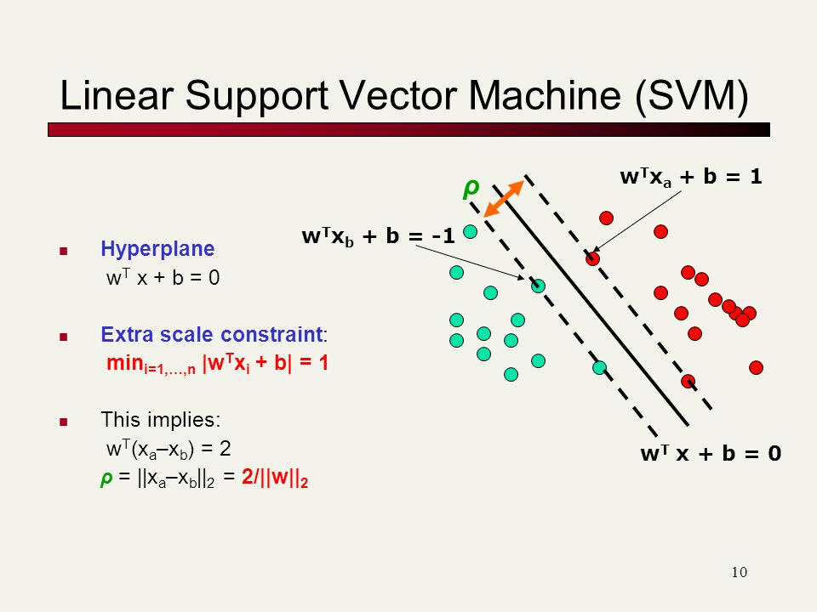

Slide 54
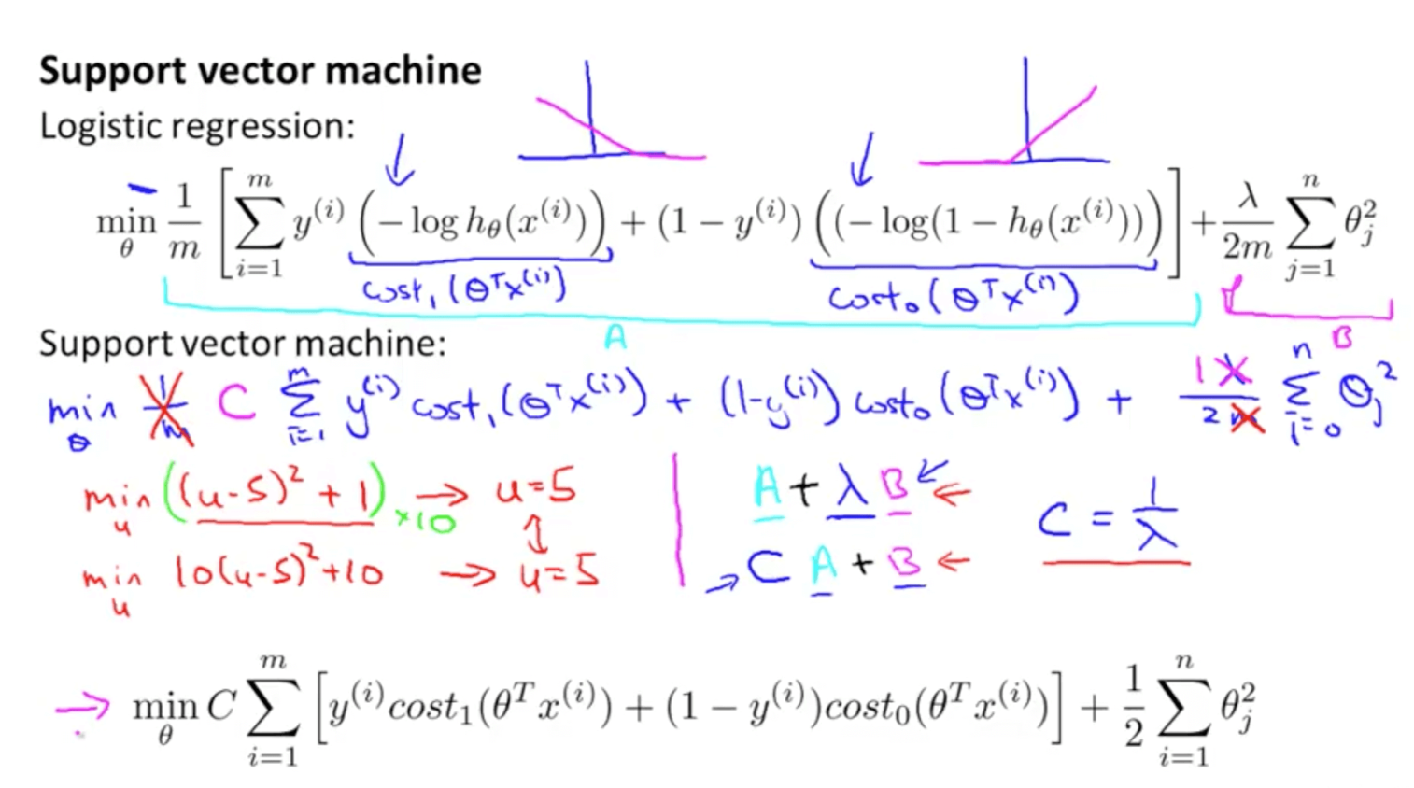

Slide 55
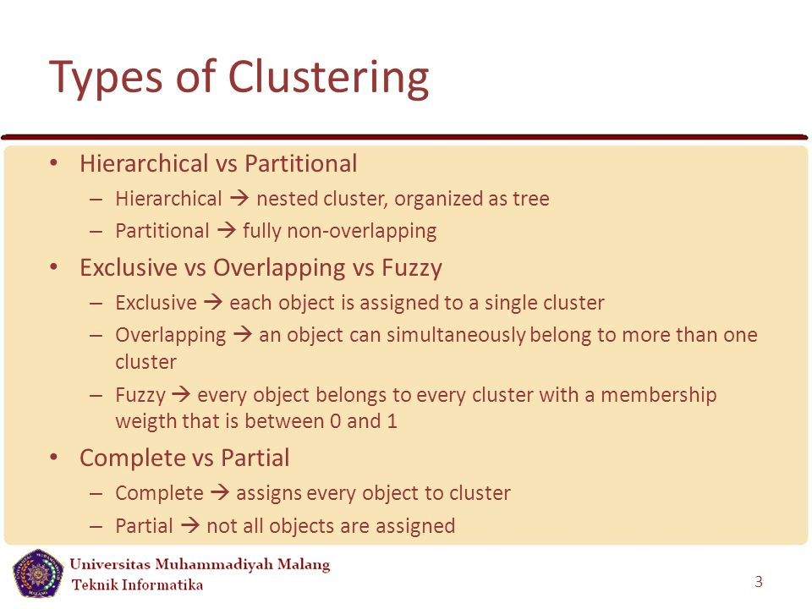

Slide 56
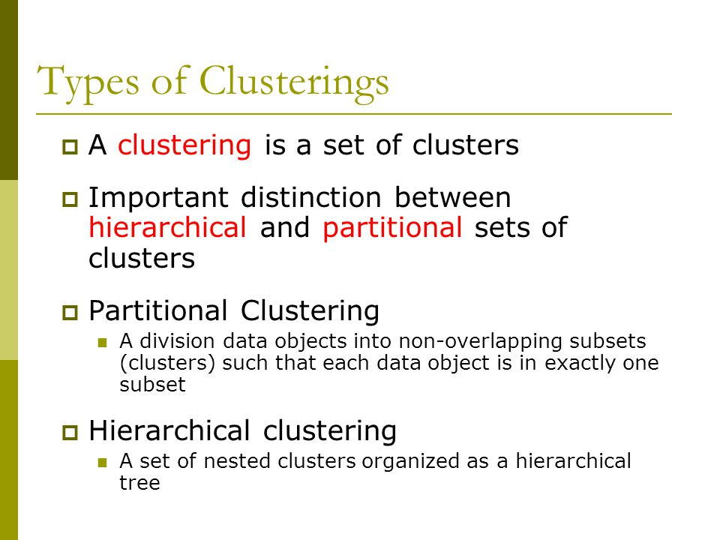

Slide 57
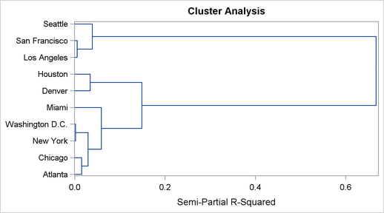

Slide 58
principal component analysis PCA
linear discriminant analysis LDA
canonical correlation analysis (CCA)

Slide 59
Principal component analysis (PCA) a statistical procedure that uses an orthogonal transformation to convert a set of observations of possibly correlated variables (entities each of which takes on various numerical values) into a set of values of linearly uncorrelated variables called principal components.

